Slide 1

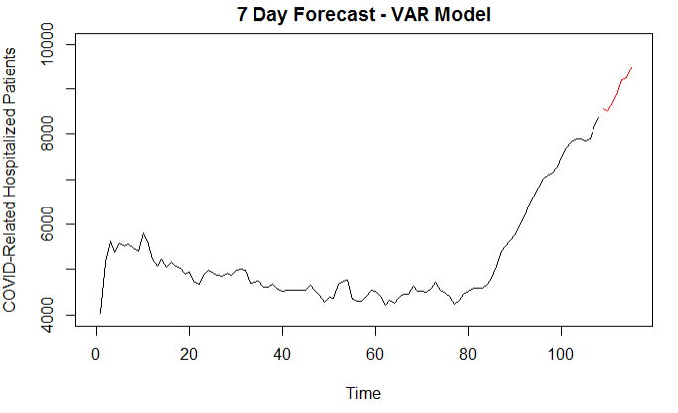

California
VAR Candidate Model
7-Day ASE
1,240,595
Notes:
Josh Notes: 32 sec
The next model built was a Vector AR model using the same two variables. We have to note that the ASE is high because when running it with the last 7 observations omitted, it creates a forecast that misses that small dip toward the end of the data because there is nothing in the previous month that would entice the model to do that.
That’s one of the reasons why comparing forecasts quantitatively is tricky when we’re in this scenario where we're seeing an increasing trend that isn’t artificial, but doesn't represent the behavior of most of our past data, and we have expectations for its future behavior. We have to observe the forecast produced every time we introduce new data and make some judgement calls about it, because visually this forecast looks very reasonable.

